Slide 1
Displaying Many Variables At Once
Chapter 11
Spencer Merrill

Slide 2
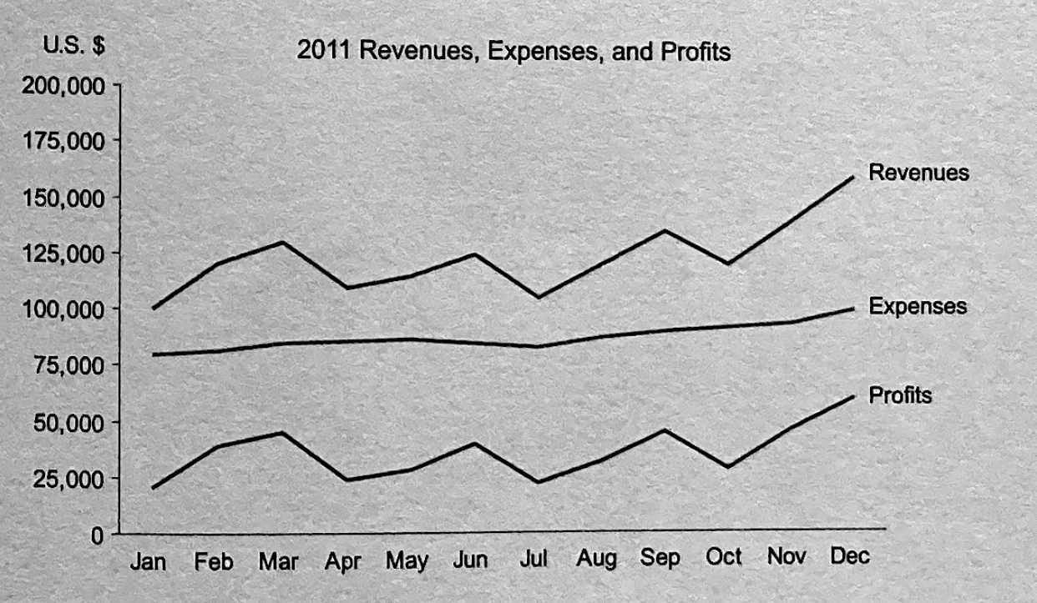
Combining Multiple Units of Measure
If multiple quantitative variables use the same unit of measure you can combine them into one graph to easily show the comparison
Works well if the data doesn’t differ by large amounts
If the data does differ by large amounts it will make the lines look flat where they might not be

Slide 3
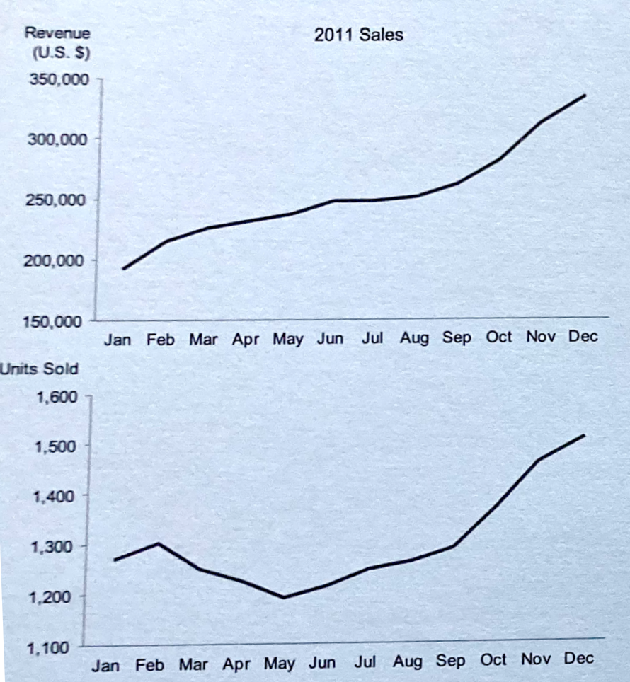
Differing Units of Measure
If the units differ, you can place them next to each other for easy comparison
This is usually the best solution

Slide 4
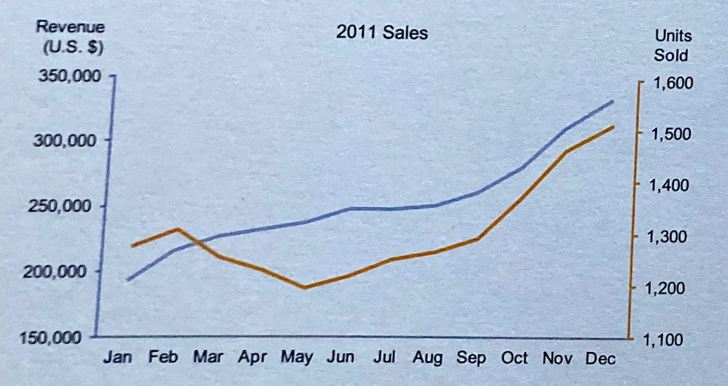
Combining with Different Units
You can choose to combine two plots with different units of measurement as long as you make it clear which units goes to which line
This makes for easy comparison between the two lines
However this may make readers want to compare the magnitude of values which is meaningless
It also draws readers to the intersection which is also meaningless

Slide 5
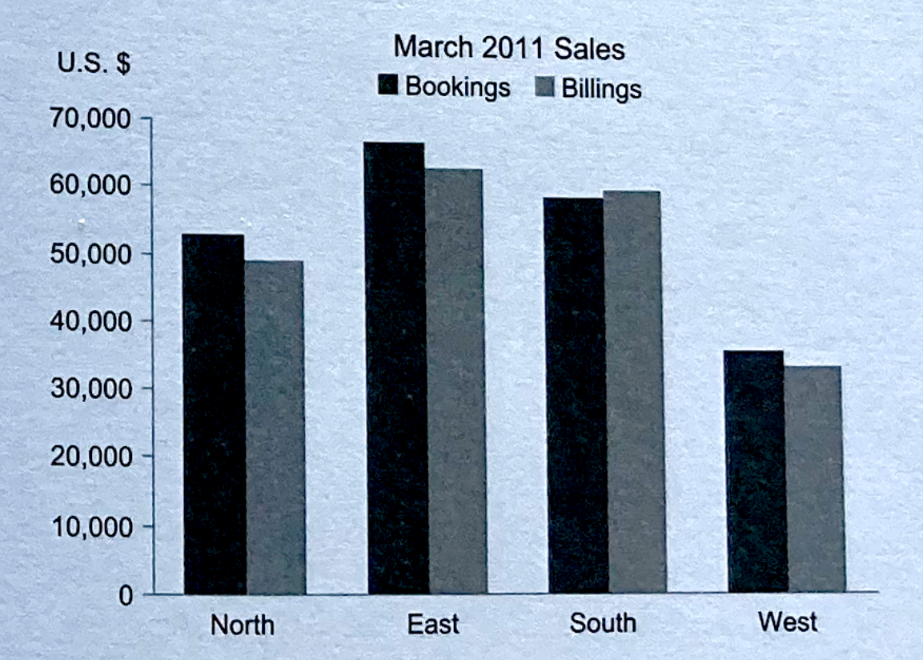
Combining Graphs in a Series of Small Multiples
Sales for both booking and billings can be shown in the same graph for each region
This allows for easy comparison between the two data points between the 4 locations

Slide 6
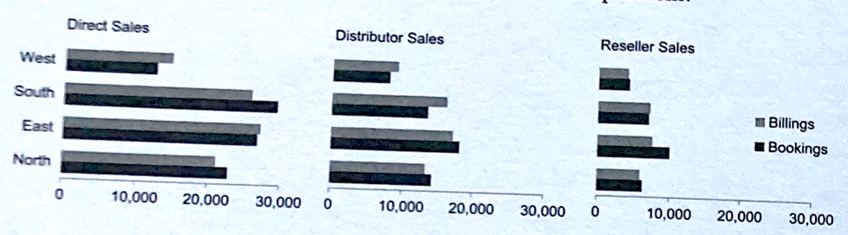
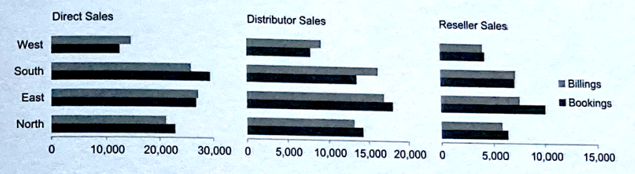
Adding more data to a single graph
Adding more data sources to give more information
Adjusting the scale makes it less clear

Slide 7
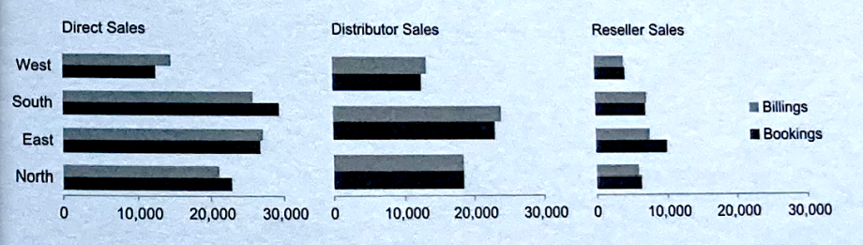
Adding more data to a single graph
Ensure that all the scales are consistent and in the same order
Here the south region is missing from distributor sales and that makes it confusing

Slide 8
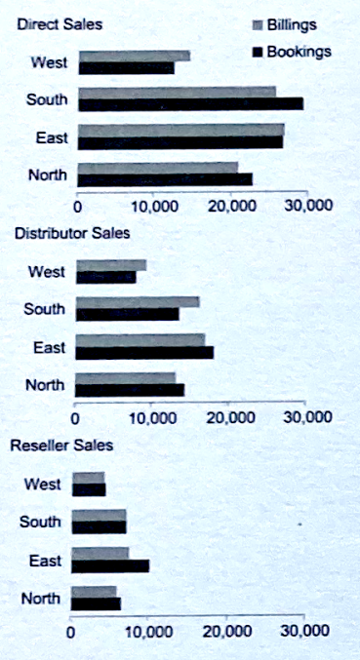
Arrangement
Arranging the data vertically makes it easier to see the direct comparisons between the 3 different types of sales in the different regions

Slide 9
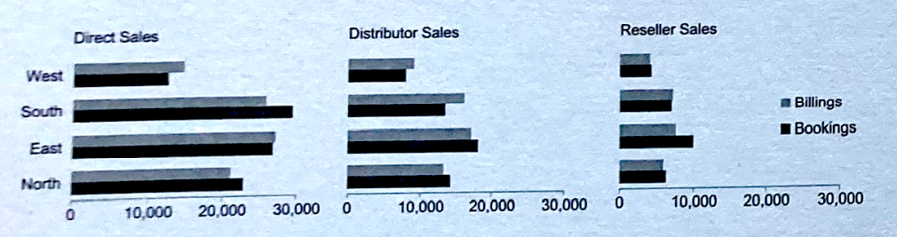
Arrangement
Arranging the data horizontally by sales type makes it easier to see the direct comparisons for a particular sales channels by looking across the row

Slide 10
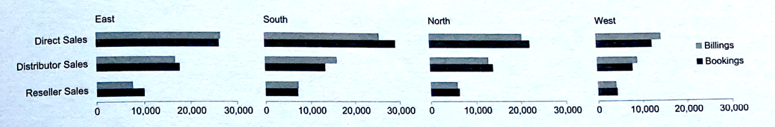
Arrangement
Arranging the data horizontally by region makes it easier to see the direct comparisons for a sales channel across different regions

Slide 11
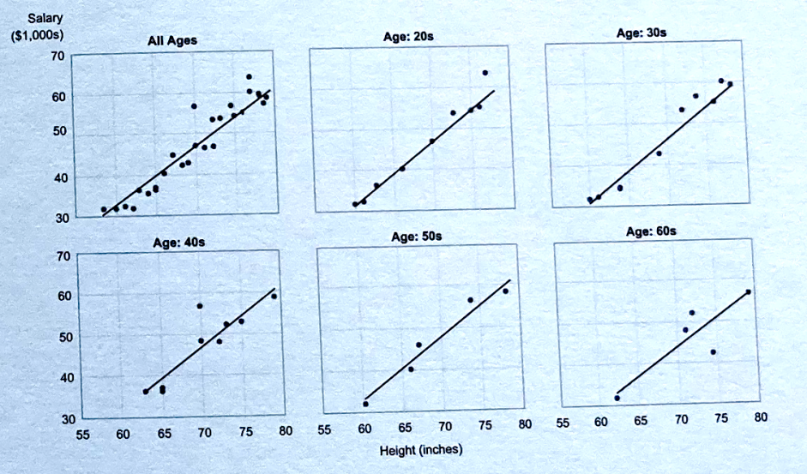
Using Matrices
Matrices can be used to separate out different data points
Smaller subsections of the data can be separated out in separate graphs displayed together
The axes are consistent across all graphs

Slide 12
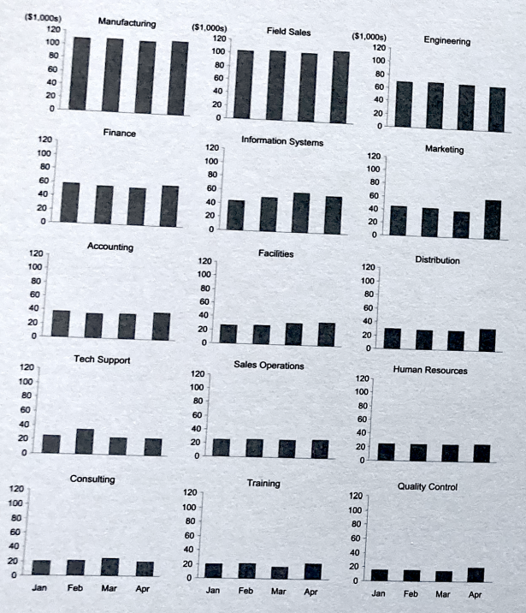
Using Matrices
Graph titles and labelling the axes can help make the graphs more clear and allows for easy comparison as long as the scale is consistent across all graphs

Slide 13
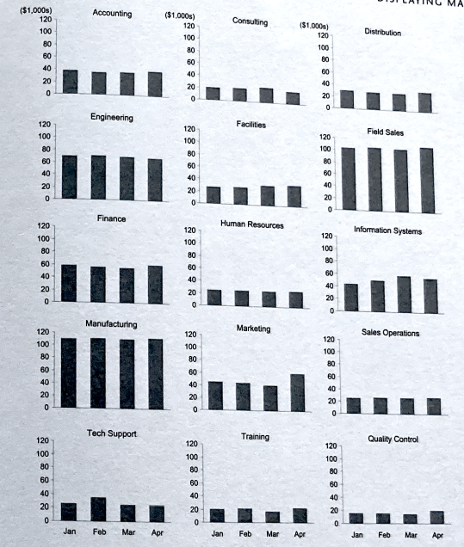
Sequencing
If there is some sort of intrinsic way to arrange the data that makes sense, ensure that you use that method
The graph on the right is arranged alphabetically which makes it harder to compare values across the graphs since the values vary from graph to graph
Compare with arranging from highest expenses to lowest

Slide 14
Sequencing

Slide 15
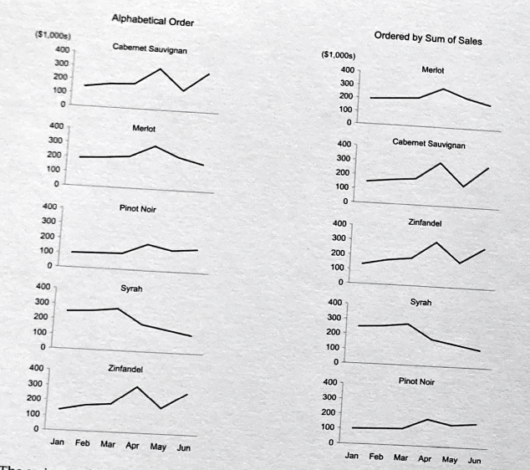
Sequencing
Another comparison of alphabetical vs sum of sales

Slide 16
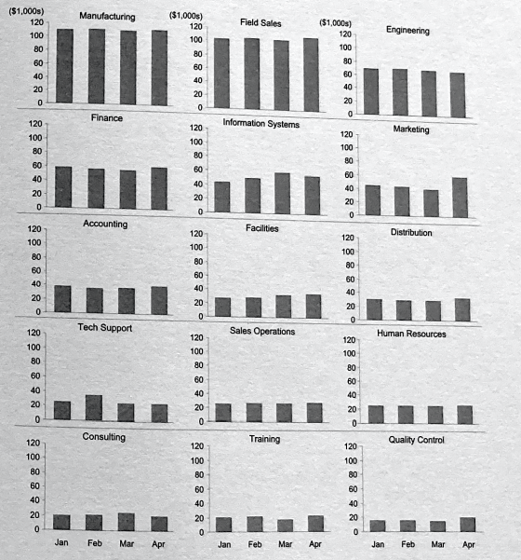
Rules and Grid Lines
Rule lines can be used to direct the reader to scan horizontally across the data
Should be subtle and not stick out a lot

Slide 17
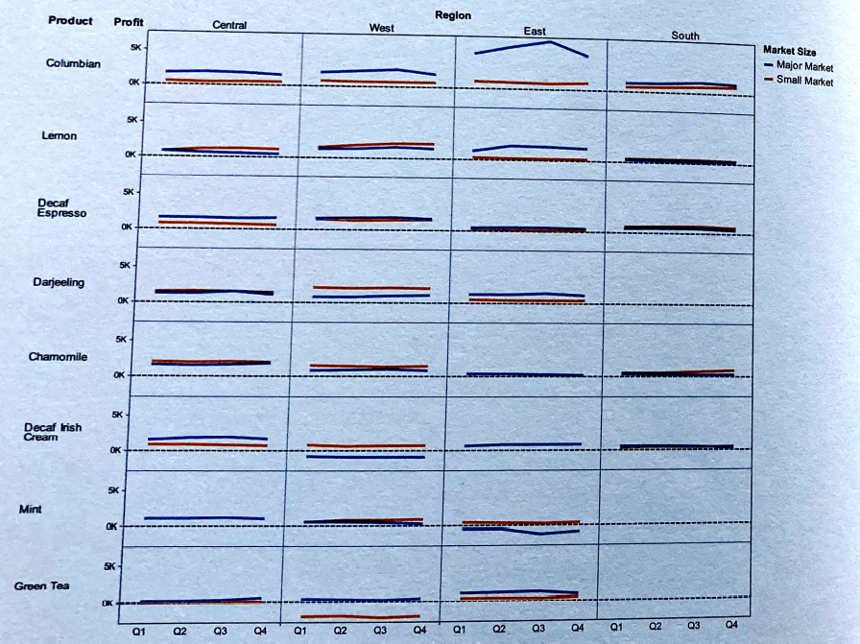
Other arrangements
With a matrix of graphs, the graphs can vary across 2 different variables if you assign one variable to the row and one to the column
Products are shown in rows, regions are shown in columns

Slide 18
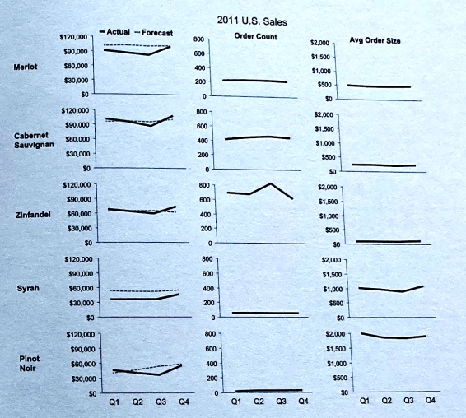
Other arrangements
When showing different units, a matrix can be used to show comparisons
Each column has a different variable, but the scale is consistent across all of them
The row is the related categorical value which in this case is the product

Slide 19
Conclusion
When you need to display two units of measurement for comparison it is best to use two different graphs and place them next to each other
When you need to add more variables to a graph but you’ve used all the practical means to visually encode values in it, you can construct a series of related graphs and display them in a matrix
Ensure the graphs are consistently designed and use the same scale
Make sure the arrangement of the graph portrays the comparison you want to focus on
If there is an intrinsic order to the graphs, make sure they are in an order that makes sense
If you cannot use whitespace to direct the reader’s attention in the manner you want, use rules or a gridline

